Slide 1
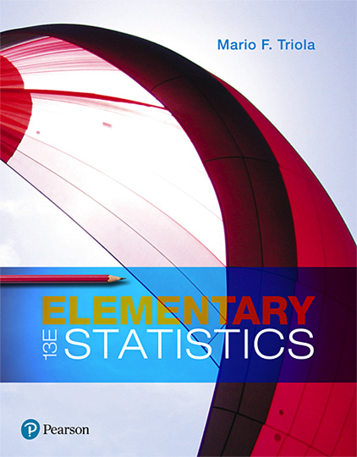
Elementary Statistics
Thirteenth Edition
Chapter 2
Exploring Data with Tables and Graphs
Copyright © 2018, 2014, 2012 Pearson Education, Inc. All Rights Reserved

Slide 2
Exploring Data with Tables and Graphs
2-1 Frequency Distributions for Organizing and Summarizing Data
2-2 Histograms
2-3 Graphs that Enlighten and Graphs that Deceive
2-4 Scatterplots, Correlation, and Regression

Slide 3
Key Concept
While a frequency distribution is a useful tool for summarizing data and investigating the distribution of data, an even better tool is a histogram, which is a graph that is easier to interpret than a table of numbers.

Slide 4
Histogram
Histogram
A graph consisting of bars of equal width drawn adjacent to each other (unless there are gaps in the data)
The horizontal scale represents classes of quantitative data values, and the vertical scale represents frequencies. The heights of the bars correspond to frequency values.

Slide 5
Important Uses of a Histogram
Visually displays the shape of the distribution of the data
Shows the location of the center of the data
Shows the spread of the data
Identifies outliers

Slide 6
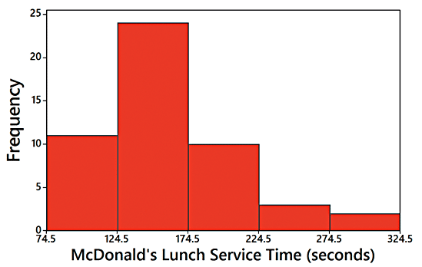
Relative Frequency Histogram
Relative Frequency Histogram
It has the same shape and horizontal scale as a histogram, but the vertical scale is marked with relative frequencies instead of actual frequencies.
Time (seconds) | Frequency
75-124 | 11
125-174 | 24
175-224 | 10
225-274 | 3
275-324 | 2

Slide 7
Critical Thinking Interpreting Histograms
Explore the data by analyzing the histogram to see what can be learned about “CVDOT”:
the Center of the data,
the Variation,
the shape of the Distribution,
whether there are any Outliers,
and Time.

Slide 8
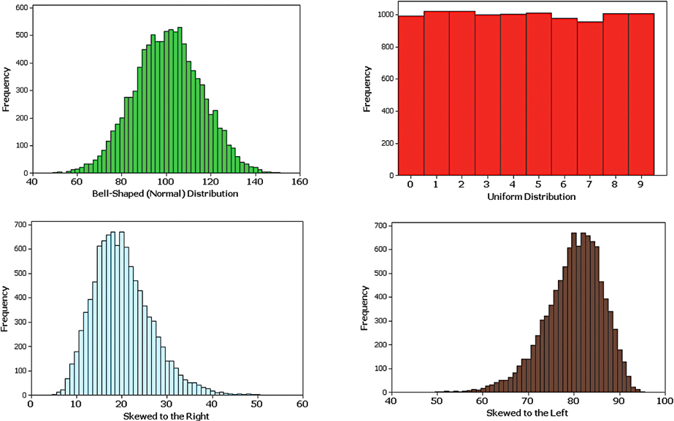
Common Distribution Shapes

Slide 9
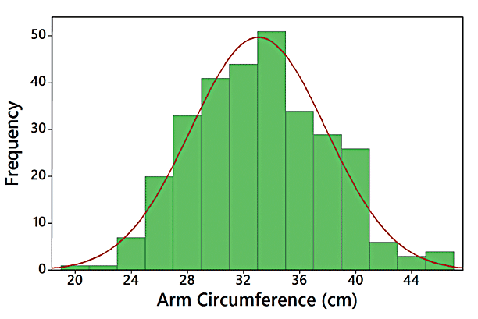
Normal Distribution
Because this histogram is roughly bell-shaped, we say that the data have a normal distribution.

Slide 10
Skewness (1 of 3)
Skewness
A distribution of data is skewed if it is not symmetric and extends more to one side than to the other.

Slide 11
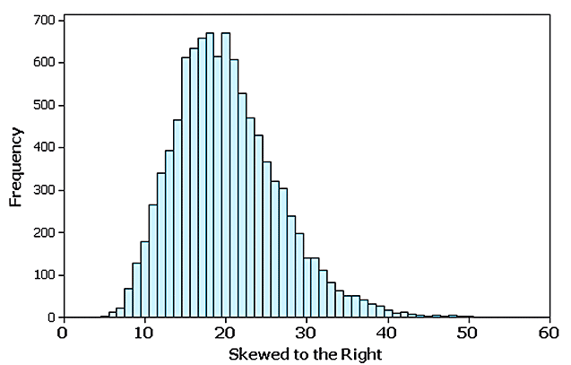
Skewness (2 of 3)
Data skewed to the right (positively skewed) have a longer right tail.

Slide 12
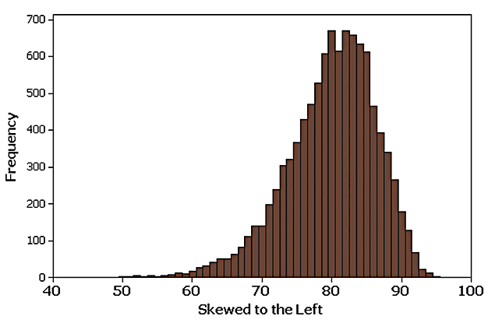
Skewness (3 of 3)
Data skewed to the left (negative skewed) have a longer left tail.

Slide 13
Assessing Normality with Normal Quantile Plots (1 of 5)
Criteria for Assessing Normality with a Normal Quantile Plot
Normal Distribution: The pattern of the points in the normal quantile plot is reasonably close to a straight line, and the points do not show some systematic pattern that is not a straight-line pattern.

Slide 14
Assessing Normality with Normal Quantile Plots (2 of 5)
Criteria for Assessing Normality with a Normal Quantile Plot
Not a Normal Distribution: The population distribution is not normal if the normal quantile plot has either or both of these two conditions:
The points do not lie reasonably close to a straight-line pattern.
The points show some systematic pattern that is not a straight-line pattern.

Slide 15
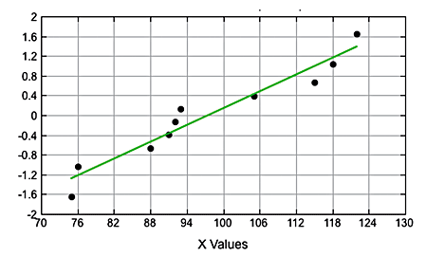
Assessing Normality with Normal Quantile Plots (3 of 5)
Normal Distribution: The points are reasonably close to a straight-line pattern, and there is no other systematic pattern that is not a straight-line pattern.

Slide 16
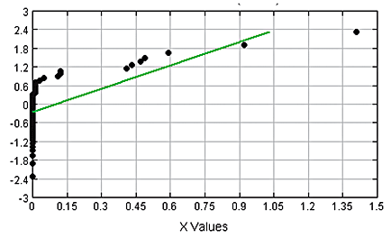
Assessing Normality with Normal Quantile Plots (4 of 5)
Not a Normal Distribution: The points do not lie reasonably close to a straight line.

Slide 17
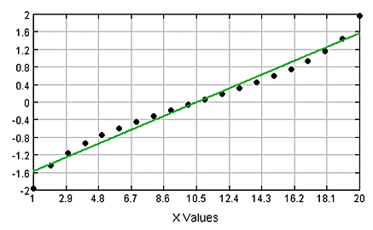
Assessing Normality with Normal Quantile Plots (5 of 5)
Not a Normal Distribution: The points show a systematic pattern that is not a straight-line pattern.

